Slide 1
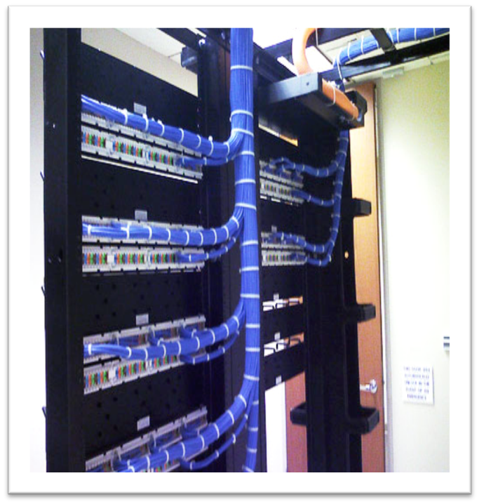
Cloud Computing is Transformational for IT
Adoption of the cloud is accelerating
Deliver innovation and business priorities
IT transformation: Org, Architecture, Ops
Leverage and Advantage
Notes:
Cloud computing has huge implications for IT and provides a new solution to help with these economic times. Our current focus is too low on the stack. The advantage of the new offereings allows us to focus on innovation and business delivery. If leveraged properly it will become a competitive advantage
Start with the picture! Use, “look at the cabiling, isn’t that just a piece of art, color coded cables….? I have spend many dollars, hours, arguments making sure our datacenter looked this good,,,but at what cost? It didn’t’ help us sell more paint”
Transition into: now today we are going to talk about how the cloud is transforming business and specific examples from two small companies on how it is making an impact.
First bullet talk about how history teaches us that fundamental changes in technology occur when large populations have access to the same tools that only the elite had access to…
The concept of my other computer is a datacenter has HUGE implication in the way we use leverage (use money here), re-shape our IT organization, DR, capacity planning roles to continuous innovation and iteration
Finally we will bring this closer to the real enterprise and how companies are taking advantage of the cloud, saving money.
Talk about Picture
There is no going back…Atomic/fission analogy
-we are going to have new winners, new losers, and the difference is how they react to this technology and today’s presentation will show you examples that work
I spent all this time…I wanted to point this picture out because I havea personal view of how technology…Question, what is the picture of this in the future? This picture does not exist!
You do not worry about this in the future, this is google, amazon, sfdc…you become business technology

Slide 2
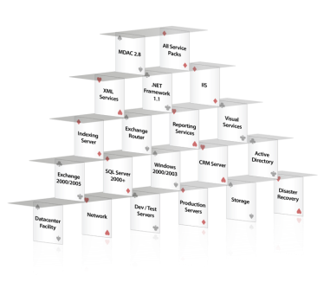
We Began with Single Tenant Complexity
Provisioning
Upgrades
Tuning
DR planning
Broken integrations
Broken customizations
Security vulnerabilities
Performance problems
Reliability problems
Unhappy customers
Deployment 1
Deployment 2
Deployment 3
Deployment 4
Deployment 5
Deployment 6
Deployment 7
Deployment 8
Deployment 9
Notes:
I have been fortunate to be part of some very well run IT organizations but at the end of the day we still have a lot to maintain…and it doesn’t sell paint.
Need a little bit of a story around
Starting small
How to leverage the cloud
Build the right change management within your organization

Slide 3
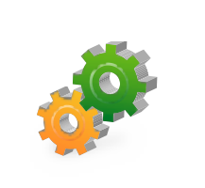



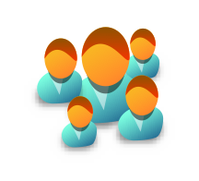
Our IT Vision: Salesforce on Salesforce
Organization
Operations
Infrastructure
Improve Productivity & Innovation
Improve Efficiency
Reduce Cost

Slide 4
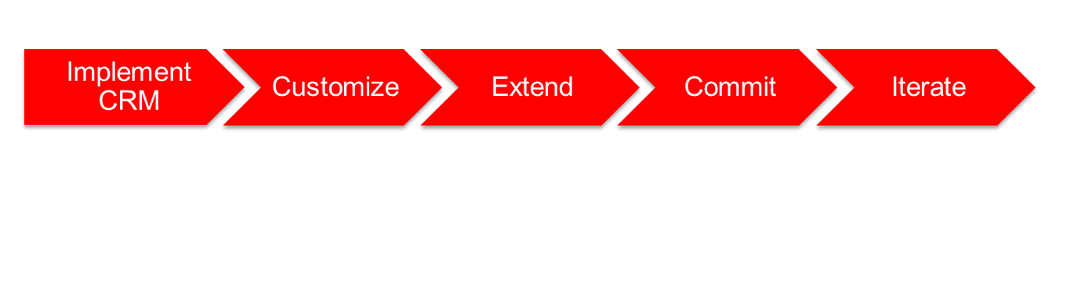
Our Transformation Took Five Stages
Implement Salesforce applications
Create business specific requirements
Add complex functionality
Design, build and deploy mission critical applications
Continuously improve existing apps and deliver new apps

Slide 5


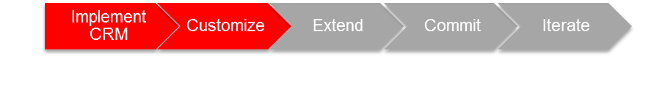
Stage 2: Customize to Automate Basic Processes
Eliminate rogue spreadsheets, manual processes and databases
Review project portfolio for cloud opportunities
Train All IT Employees on Force.com
Develop integration strategy and solutions
Notes:
This is where we had Jon Mar focused on building the quarterly certification object. It is a time to start training the developers and admins and also provide IT automation tools.

Slide 6
Stage 5 Iterate: Run Our Business in the Cloud
Human Capital Management
Customer Service
Sales & Marketing
IT Infrastructure
Compliance and Risk
Finance
Development
Workday HCMD
Salary.com Salary Manager
Performance Management
Time-off Manager
Volunteer tracking
ADP Payroll
iemployee Time Tracking
Coupa Procure to Pay
Concur T&E Manager
Manhattan Space & Lease Management
Contract Management
Salesforce Customer Service
Salesforce Content
Salesforce Ideas
Plateau Learning Management
Professional Services Management
SFA
Marketing
Click to dial (CTI Integrations)
Event Management
Opportunity to Quote
Quote to cash
Sales Compensation
Checkout E-commerce
Live Chat (Google)
Development Domain
Program and Resource Management
Agile Scrum and Bug Management
QA Test Director
IT Infrastructure Support
Portfolio Management
Compliance
IT Help Desk
LiveOps
Asset Management
Intranet
Google Apps
Compliance/Risk Domain
Audit Controls Management

